Slide 1

PROGRAMMING WITH JAVASCRIPT
Prepared By: Muniba Javed

Slide 2
Objectives
By the end of this session, students will learn to:
Define JavaScript
Differentiate between JavaScript and Java
Describe Web Applications and Websites
Compare and contrast between server-side and client-side scripting
Explain basic concepts of JavaScript

Slide 3

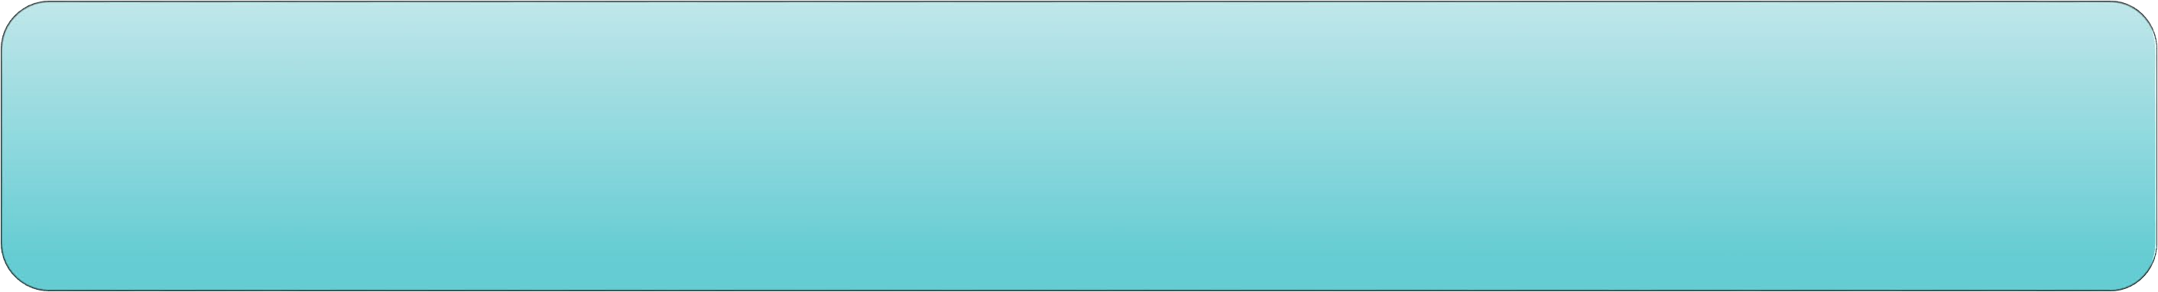
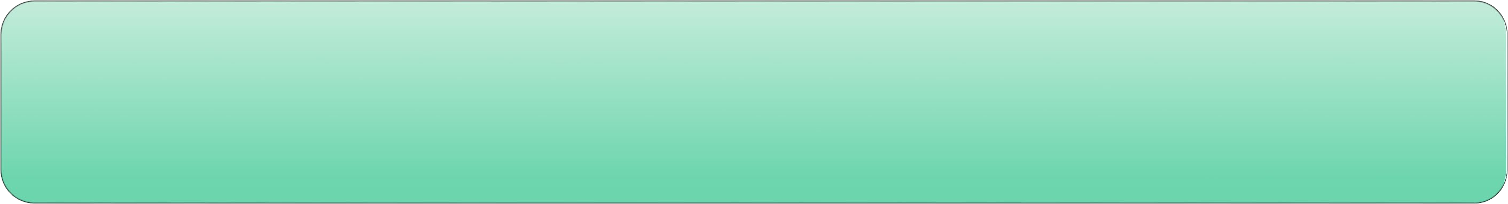
Introduction to JavaScript
JavaScript is a scripting language.
Mainly used in Web pages to improve design, validate forms, detect browsers, and create cookies.
By default, all Web browsers have in-built JavaScript support.

Slide 4
HTML, CSS, and JavaScript
Is used to form the skeleton of a Website
Acts as a building block of Web Scripting
Describes the arrangement of the content
HTML
Cascading Style Sheets (CSS)
Is used to create an appealing Website
Helps design graphic elements that improve the appearance of the Websites
Defines the color, size, and other visual aspects
Allows Web pages to be more interactive and independent
Enables the code to be embedded in HTML markup or stored in a separate file
JavaScript

Slide 5
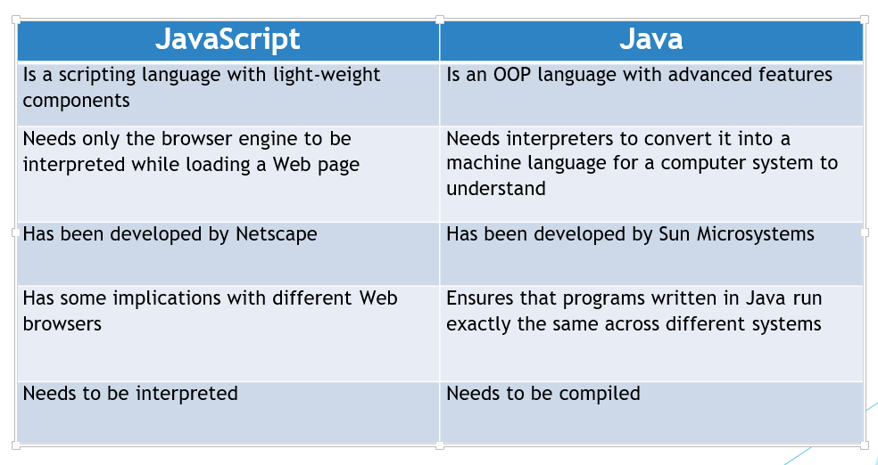
JavaScript and Java

Slide 6
Websites and Web Applications
Usually contains more of static information and less of user interaction.
Will not take any input from the user and does not interact with the Web server.
Can be built using HTML, CSS, and JavaScript.
Website
Is more interactive and require a connection with a Web server.
Is dynamic as it takes input from users, interacts with the server, and provides response back to users.
Can be built with HTML, CSS, JavaScript, and programming languages.
Web Application

Slide 7
Server-Side Script versus Client-Side Script
Server-side Script
Client-side Script
It runs on a Web server.
It runs on a Web browser.
Additional components such as Webserver, Application server, and Database are involved.
Browser is the only component involved.
Server provides results for user’s dynamic requests.
Response is faster; server load is reduced.
Specific response is sent back for each user’s request.
Code runs on browser that is downloaded from the Web server

Slide 8
JavaScript Data Types
Six types are considered to be primitives.
Number -- integers, ﬂoats etc
String -- an array of characters
Boolean -- true or false
Null -- No Value
Undeﬁned -- a declared variable but hasn’t been given a value
Symbol -- a unique value that's not equal to any other value

Slide 9
JavaScript Variables
◆ Variable helps us to store values.
◆ A variable name is used to assign values.
◆ The value changes during the execution of a program
Example: var a= 2;
var b= 4; var c= a+ b;
Output:
The value of c is: 6

Slide 10
Control Statements 1-2
Control statements are blocks of code that perform a specific operation based on conditions provided.
if … else
switch…case
Definition:
o The 'if' statement will execute a block of code when a required condition is satisfied.
Syntax:
if (condition)
{
Statements to be executed If condition is true
}
Definition:
o The 'switch' statement checks different conditions. It checks for each case against the condition until a correct match is found.
Syntax:
switch (condition)
{
case condition 1: statements; break; case condition 2: statements; break;
...
case condition n: statements; break; default: statements;}

Slide 11
Control Statements 2-2
do…While
do…While
While
While
For loop
For loop
Definition:
The 'do...while' loop checks for the condition at the end of the loop.
The 'do' loop will be executed at least once, even if the condition is false.
Syntax:
do
{
Statements to be executed;
}
while (condition);
Definition:
The 'do...while' loop checks for the condition at the end of the loop.
The 'do' loop will be executed at least once, even if the condition is false.
Syntax:
do
{
Statements to be executed;
}
while (condition);
Definition:
The 'while' loop executes a statement or a block of code repeatedly as long as the condition is true.
When condition is false, the loop will exit.
Syntax:
while (condition)
{Statements to be executed if condition is true}
Definition:
The 'while' loop executes a statement or a block of code repeatedly as long as the condition is true.
When condition is false, the loop will exit.
Syntax:
while (condition)
{Statements to be executed if condition is true}
Definition:
The 'for' loop is used to execute a block of code multiple times for a specific condition.
It has three parts: the loop initialization, the condition is true or not, and the iteration statement that can increase or decrease the counter.
Syntax:
for (initialization; condition; iteration statement)
{Statements to be executed if test
condition is true}

Slide 12
Object-Oriented Programming (OOP)
In OOP, the major building block of a script is an object.
Each object is a scripting unit consisting of a state (variables) and behavior (methods).
JavaScript is an OOP-based scripting language.
Polymorphism
Inheritance
Classes and Objects
Encapsulation and Abstraction
OOP

Slide 13
Creating Classes and Objects in JavaScript
A class is similar to a function, but a class should be declared before accessing it in the script.
Objects can be created using one of the three ways:
Using object literal
Using new keyword to create instance of Object directly Using an object constructor and new keyword

Slide 14
JAVASCRIPT REGULAR EXPRESSION
A regular expression is a sequence of characters that forms a search pattern.
The search pattern can be used for text search and text replace operations

Slide 15
What is Regular Expression
A regular expression is a sequence of characters that forms a search pattern.
When you search for data in a text, you can use this search pattern to describe what you are searching for.
A regular expression can be a single character, or a more complicated pattern.
Regular expressions can be used to perform all types of text search and text replace operations.
SYNTAX
/pattern/modifiers; Or /w3schools/i;

Slide 16
Cont.......
Example explained:
/w3schools/i is a regular expression.
w3schools is a pattern (to be used in a search).
i is a modifier (modifies the search to be case-insensitive).

Slide 17
Using String Methods
In JavaScript, regular expressions are often used with the two string methods: search() and replace().
The search() method uses an expression to search for a match, and returns the position of the match.
The replace() method returns a modified string where the pattern is replaced.

Slide 18
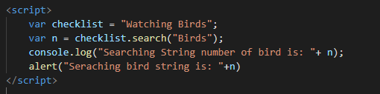
Using String search() With a String
The search() method searches a string for a specified value and returns the position of the match:
Simple Example

Slide 19
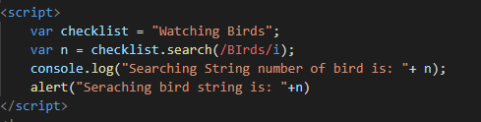
Using String search() With a Regular Expression
Example

Slide 20
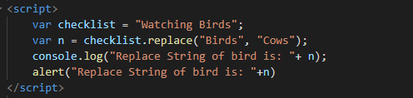
Using String replace() With a String
The replace() method replaces a specified value with another value in a string:
Example:

Slide 21
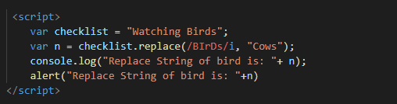
Use String replace() With a Regular Expression
The replace() method replaces a specified value with another value in a string:
Example:

